Slide 1
VACCINATION TREND PREDICTOR
Project by:
Annastasiah Muchau

Slide 2
Business Problem Definition
To develop a model that will provide guidance to the National Vaccination Advisory committee in understanding how people’s backgrounds, opinions, and health behaviors are related to their personal vaccination patterns.
The model will guide the committee on advising the Director of National Vaccine program on planning future vaccination efforts.

Slide 3
Data Understanding
The data used in this project is from the National 2009 H1N1 Flu Survey collected to monitor vaccination rates during the US government vaccination campaign.
The survey asked people whether they had received H1N1 and seasonal flu vaccines and additional information about their lives: race, marital-status, age, employment-status, their opinions and behaviors. The project uses three datasets:
training_set_features.csv
training_set_labels.csv
test_set_features.csv

Slide 4
The Process
1. Preparing the data: inspect the dataset; checking for missing values.
2. Analyzing the data so as to understand the distribution of the dataset- used bar charts.
3. Creating a model to help make conclusions and recommendations

Slide 5
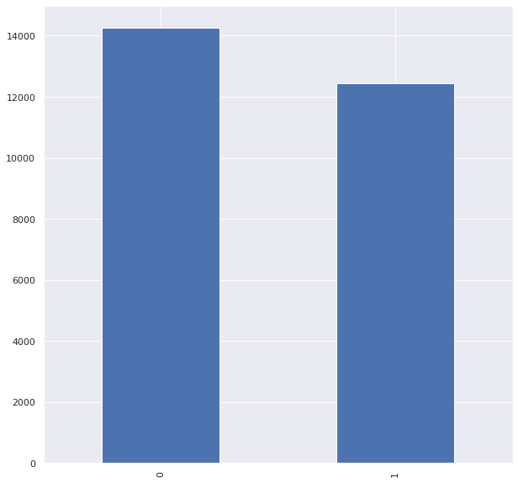
Analysis Results

Slide 6
Modelling Results
Accuracy | Precision | Recall
Logistic Regression | 0.791373 | 0.740298 | 0.795068
Support Vector Machines | 0.787030 | 0.730918 | 0.792982
Decision Trees | 0.696570 | 0.690815 | 0.666251
Random Forest | 0.783885 | 0.769082 | 0.765369
Naive Bayes | 0.697619 | 0.806274 | 0.637107
K-Nearest Neighbor | 0.736109 | 0.688228 | 0.727273

Slide 7
Findings from the model
Our best training model has a prediction accuracy of 79.1% and A True Positive Rate of 79.5%.

Slide 8
Conclusion
The number of people who received the seasonal vaccine is lower than those who didn't receive the vaccine.
Most of those who received the vaccine were male.
Most of the health workers received the vaccine.
The older people(65 Years and above) received the vaccine in high numbers compared to the young people.
The number of those who received the vaccination through recommendation by a doctor was also high.
People with chronic medical conditions did not receive the vaccine.
Factors like Education level, employment status and race rarely affected the vaccination rate.

Slide 9
Recommendations
Educate people on the importance of vaccination(doctors'reccomendation helps).

Slide 10

Questions

Slide 11
Thank You

